Slide 1
Excellence Frameworks
Hosted by Pablo Baez, ASQ
Presented by Shawn W. Flynn, CSSBB, CQE, CSSGB, CQT
2018

Slide 2
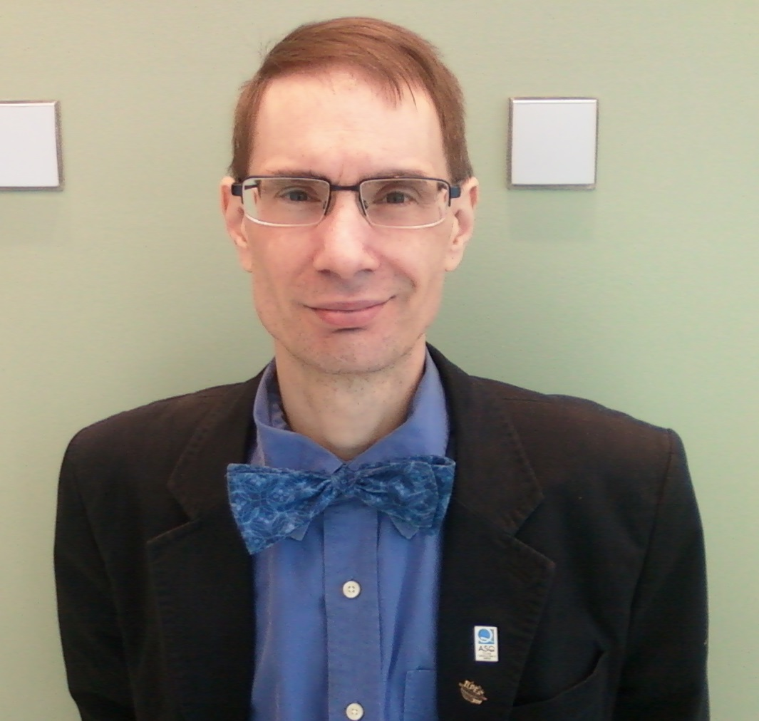
About the presenter- Shawn W. Flynn
20 years of industry experience.
10 years analyzing organizational and team performance.
Founder of Black Knight Management.
Consultancy for organizational and personal transformation.
Baldrige Examiner in Illinois.
Additional service in other state programs.
Judge for ASQ’s International Team Excellence Awards.
Also served as Lead Judge and Trainer.
Subject Matter Expert for multiple ASQ certification and course development projects.
Including the Certified Six Sigma Green Belt and Supplier Quality Professional.
Degrees in liberal arts, management and natural health.
Master of Science in Industrial Management, University of Central Missouri
Doctorate in Naturopathy, Trinity School of Natural Health.
ASQ CQT, CQE, CSSGB and CSSBB.

Slide 3
In this webcast, you will…
Gain an understanding of Excellence
Frameworks.
See and explore different types of excellence models.
Learn about the history, benefits, applications and development of frameworks and the future of excellence initiatives.

Slide 4
Introduction and History-What is Excellence?
Origins: Latin and Middle English from “excellere” or Greek “arete”.
A comprehensive and simple definition:
A quality or state of being that surpasses expectations.
Exhibiting (high) performance, talent or skill beyond the ‘normal’ range.
Quotes:
“We are what we repeatedly do. Excellence then, is not an act, but a habit.”
-Will Durant
“Perfection is not attainable, but if we chase perfection, we can catch
excellence.” -Vince Lombardi
“Excellence is not a skill. It is an attitude.” -Ralph Marston
History:
Developed over time through societal and governmental demands for better products and services for competitive advantage and quality through organized competitions, models and assessments through increasingly complex (or simplified) means (criteria, requirements or standards).

Slide 5
What are Excellence Frameworks?
Structured models using integrated approaches for organizational and
performance management.
Characteristics of Frameworks and Programs:
Employ an adaptable structured or holistic operating model, standard or
criteria.
Provide systems perspective through an integrated management system
or program.
Deliver ever-increasing customer and stakeholder value.
Improve organizational effectiveness and sustainability.
Develop increasing levels of organizational maturity (processes,
methods, culture and behaviors and marketplace results).
Often establish internal programs, offices and positions.
Development of internal excellence models and programs.
Cycles of learning and improvement and success and recognition.

Slide 6
What they have in common
Creates standardization by having a common language.
Holistic way. It promotes multiple approaches, not one best way.
Homeostatic alignment and integration across the organization.
Non-prescriptive and non-judgmental model.
Incorporates learning, improvement and recognition.
Incorporates measurement with linkage to key business results including operational, financial and benchmarking.
Not all programs have these but…
Additional elements may include, incorporate or inspire:
Innovation (meaningful change to a new or existing application)
Intelligent risk
Social, communal and possibly ecological components

Slide 7
Makes, types and styles of frameworks
Make of Models:
National (countries or nation states)
Regional (states or territories)
Local (counties or districts)
Professional associations or societies
Companies
Styles:
Holistic, hybrid and specific application
Size and scope (assessment level):
Macro: Whole organization or facility
Micro: Sub-unit, department and project or process

Slide 8
Award process characteristics
Criteria based (with point or rating system)
Structured and non-prescriptive
Trained evaluators:
application, pre-training work and site (and web training)
Assessment Process:
Intent to apply
Application document or project evaluation
Multi-level review process by evaluators (examiners, assessors, judges and etc...)
Site visit evaluation
Feedback report preparation with more multi-level review: (structured (strengths and gaps) and / or unstructured).
Recognition:
Award level
Feedback report with debrief
Formal recognition-an Award

Slide 9
Criteria characteristics
Facts and Impacts of Excellence Models
Over 100 excellence models world wide.
Most based off the Baldrige or EFQM models.
The ratio of Baldrige Program benefits for the U.S. economy
to program costs has been estimated at 820 to 1.
120 award winners surveyed by the British Quality
Foundation outperformed comparison companies over 11
years.
Australian Business Excellence Framework applicants reported share performance increases by of a factor of 3.5 to 1.
Notes:
Sources:
Baldridge Excellence Framework, 2017-2018. National Institutes of Standards and Technology (NIST), US Department of Commerce, Gathersburg, MD, USA.
2. http://www.businessexcellencetools.com/business-excellence/#ap

Slide 10
Applications: Reasons to adopt
Both business and personal applications:
Gain competitive advantage and market share.
Higher operating efficiency and cost reduction.
More engaged employees
Greater customer satisfaction
Organizational sustainability (stay in business!)

Slide 11
Applications: Reasons not to adopt
Complexity of Frameworks and Models
Resistance for buy-in and set up.
Implementation complexities:
Development of internal mechanisms (best practices) and personnel.
Discipline to sustain processes and measurements.
Results take time to yield impact
Slow change and progress
Initial benefits may or not be observable.
Average of 3 years to see bottom line impact.

Slide 12
Reasons not to adopt: Pitfalls
Scope: “Ye know not what ye ask for.” (Mark, 10:38)
Being passive, the “Explorer” approach.
Commitment, understanding, resource allocation and
support. These are success keys.
Activity/Execution:
Non-disciplined performance or practice
Not a habit
Sustainability (longevity):
Discipline (backsliding)
Burnout

Slide 13
Applications: Personal
Develop a different mind set, attitude and philosophy.
Learn to see strengths and gaps as a ‘consumer’ as opposed
to ‘producer’ (professional).
Start demanding excellence everywhere. Stop accepting the
norm or less than what could be (highest potential).
Create a different way of being.
Becoming a better person and professional.
Use excellence as a life skill to gain personal mastery.
Vehicle for personal transformation through disciplined approaches (continual refinement and recycling).
Increase personal performance, engagement and quality of life!

Slide 14
Summary: In this webcast you learned about
What constitutes excellence.
Gained an understanding of excellence frameworks and their…
Commonalities
Makes and types of frameworks
Award process and Criteria characteristics
Applications

Slide 15
How does this work?
The Dance
Integrated approaches of organizational processes, systems and people. It’s about balance, harmony and alignment!
It’s a Journey not a Destination!
Metaphors and symbols of growth and transformation:
Animals: Butterfly and the frog.
Nature: Acorn
Human achievement: Climbing a mountain, academic
success or other milestones in life.
Phoenix
Hero’s Journey (becoming)

Slide 16
Maturity
Levels 1 and sub-levels. Initial, survival mode. Processes unpredictable. Poor control and reactionary.
Level 2, Defined: Growing process and project orientation.
Level 3, Managed: Growing proactivity with organizational consciousness and standardization.
Level 4, Quantification and management through measurement and control. (Localized to distributed deployment.)
Level 5, Optimization: Focus on improvement and continual improvement. (Becoming a benchmark.)
Level 6, Actualization: Continual state of transformation-breaking through plateaus.
Level 7 (and beyond): Service and transcendence. State of humanitarianism, return to roots and global unity. Shaping society.

Slide 17
Employer benefits and payoffs
Transform your organization's body, mind and spirit.
Become a Model of Excellence:
1. Gain competitive advantage, build a better company and improve the bottom line!
2. Learn best and effective practices from different industries.
Develop, increase and strengthen stakeholder, community and societal linkages, engagement and support.
Gain industry recognition for undertaking the excellence journey.
Sustainability: People, Planet and Profit (Triple Bottom Line).

Slide 18
Employer benefits and payoffs
Gain in-house technical experts.
Become part of the community of people and companies actively
committed, practicing and journeying toward ever increasing levels of
optimization and innovation.
Potential to undertake self-assessments using established, well-ordered
frameworks and integrated management systems.
Potential to apply for excellence framework awards, receive actionable
feedback and gain brand recognition (both as award recipient and
reputation).
Potential to develop in-house frameworks and benchmark against
established Excellence Frameworks.

Slide 19
Sponsorship
Internal
Create a new organizational dynamic, focus and direction.
Transform internal and external practices and relationships.
Create new roles (part and full time).
Achieve breakthrough improvement and innovation.
External
Sponsor individuals and teams to develop expertise, grow professionally and for facilitating the internal transformation.
Participate in events to advocate excellence and inspire other organizations on their journey.
Become a success story!

Slide 20
Individual benefits
Skills and Learning:
Gain the skills of a Mini-MBA
Develop analytical and problem skills, critical thinking, communication and leadership, business acumen and team skills.
Learn diagnostic assessment tools and systems thinking.
Evaluate organizational, project, process and business results.
Exposure to different industry sectors, cultures and values.
Become a better business writer.
Learn structured feed back writing.
Work in high performing teams:
Work independently, in (small to large) teams/groups and at applicant organization sites. High performing is characterized as: agile, engaged, customer-stakeholder focus, perform with ego-less, learning and expertise.
Develop interpersonal and interviewing skills.
Intense and personally challenging experience.

Slide 21
Individual benefits
Rewards and Recognition:
Potential for greater personal and professional growth:
Coaching, mentoring and teaching opportunities.
Leadership opportunities of assessment teams and site visits.
Networking, honorariums (certificates, apparel, etc…) and
participation at recognition ceremonies.
Recognition as expert and ambassador of excellence models.
Make a difference for an organization working to improve.
Take back job enhancing skills, knowledge and
experience to help your organization!

Slide 22
Internal framework and program development
How to adopt and develop?
Beginnings: Laying the groundwork
The need for a model.
Choosing a model (s) or an organization to:
Benchmark, emulate and learn best practices.
Examine current practices and needs,
Identify, analyze and model best practices,
Evaluate gains and learnings, then repeat cycle.
Develop internal structures:
Top level support and resources.
Experimentation to adapt or create infrastructures.
Use of external experts (consultants).
Practice fundamental concepts.
This is the student or novice level.

Slide 23
Framework development
Key Elements and Themes:
Leadership, Governance and Planning/Strategy
Organizational Alignment and Maturity: Harmonization, homeostasis, integrated
management systems.
Maturity: From reactionary to ordered and systematic; analysis and prevention
(from learning) to strategic and aligned to integrated and deployed.
Organizational Identity: Core competencies, branding, culture and values.
Stakeholder Involvement: internal and external.
Internal: Employees, business sub units, and processes.
External: Customers, suppliers and partners. Societal engagement.
Processes and Methods: Work processes, resources and management.
Metrics: Departmental or functional/sub unit, business unit/division, enterprise.
Learning: Continual improvement, data based decision making.

Slide 24
Journeying
Developing capabilities. Modeling replaced with habit.
Changes in the organizational landscape and culture.
Formal development of internal personnel and programs.
Developing core values, internal body of knowledge and sharing.
Repeated cycles of refinement through practice and learning.
Gains in maturity.
Maturing Characteristics:
Benchmarking cycles for improvement, feedback and recognition through:
Conducting self-assessments with internal and external consultants.
Award program application: step programs, then full application cycles.
Greater wide spread program adoption and engagement throughout organization.
Social sponsorship (community, ecological and partner/supplier involvement).
Beginnings of innovation and intelligent risk.
Further cycles of refinement, practice and gains in maturity.
This is the disciple or journeyman level.

Slide 25
Advanced practice
Gaining Mastery: Expert
Capabilities developed.
Adopted models and methods established as part of operating structure.
Focus on sustaining gains, greater adaption and optimizing.
Application and reapplication to award programs is habit.
Pioneering efforts characterized by:
Developing internal excellence frameworks.
Design and experimentation with innovation and risk.
Developing role model behavior through branding and social sponsorship.
Mastery and pioneering:
Robust deployment of continuous improvement and excellence models.
Emphasis on market expansion and innovation.
Established industry role model.
Set and designing standards/ models.
Change the industry (globally): culture, landscape and trends.

Slide 26
Summary: In this webcast you learned about
Importance of organizational alignment
Organizational maturity levels
Benefits and sponsorship
Internal framework development
and
Taking the Excellence Journey

Slide 27
Frameworks and models
Facts and Impacts of Excellence Models
Over 100 excellence models world wide.
Most based off the Baldrige or EFQM models.
The ratio of Baldrige Program benefits for the U.S. economy
to program costs has been estimated at 820 to 1.
120 award winners surveyed by the British Quality
Foundation outperformed comparison companies over 11
years.
Australian Business Excellence Framework applicants reported share performance increases by of a factor of 3.5 to 1.
Notes:
Sources:
Baldridge Excellence Framework, 2017-2018. National Institutes of Standards and Technology (NIST), US Department of Commerce, Gathersburg, MD, USA.
2. http://www.businessexcellencetools.com/business-excellence/#ap

Slide 28
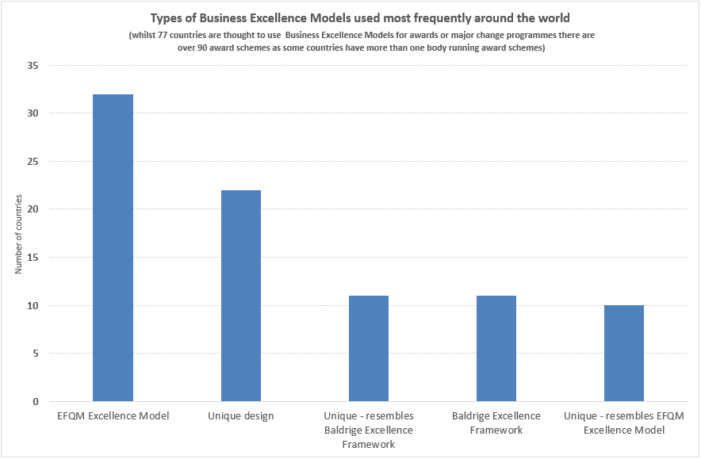
Model Usage
Notes:
Sources:
Baldridge Excellence Framework, 2017-2018. National Institutes of Standards and Technology (NIST), US Department of Commerce, Gathersburg, MD, USA.
2. http://www.businessexcellencetools.com/business-excellence/#ap

Slide 29
Detailed examples
Deming Prize
Baldrige Performance Excellence Program
EFQM
Shingo Prize for Operational Excellence
Unique Models

Slide 30
Criteria and Feedback Example Design
Deming Prize
Baldrige Performance Excellence Program
EFQM
Shingo Prize for Operational Excellence
Unique Models

Slide 31
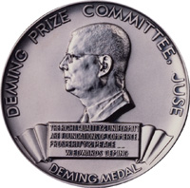
Deming Prize
Administrated by Union of Japanese Scientists and Engineers (JUSE).
Began in the 1950’s and Total Quality Management centered.
Based on Deming’s courses: “Eight-Day Course on Quality
Control” and “One-Day Course on Quality Control for Top Management”.
4 Categories:
Deming Prize for Individuals,
Deming Distinguished Service Award for
Dissemination and Promotion (Overseas),
Deming Prize and
Deming Grand Prize (former Japan Quality Medal)

Slide 32
Deming criteria
Establishment of business objectives and strategies and top management’s leadership.
I Establishment of proactive customer-oriented business
objectives and strategies.
II Role of top management and its fulfillment.
Suitable utilization and implementation of TQM.
III Suitable utilization and implementation of TQM for the
realization of business objectives and strategies.
(7 sub criteria items)
Effects of TQM
IV Effects obtained regarding business objectives and
strategies through utilization and implementation of TQM.

Slide 33
Deming criteria example
Suitable utilization and implementation of TQM.
III Suitable utilization and implementation of TQM for the realization of business objectives and strategies.
1. Organizational deployment of business objectives and strategies.
2. Creation of new values based on understanding of customer and social needs and innovation of technology and business model.
3. Management and improvement of quality of products and services and/or work process.
4. Establishment and operation of cross-functional management systems such as quality, quantity, delivery, cost, safety, environment, etc. across the supply chain.
5. Collection and analysis of information and accumulation and utilization of knowledge.
6. Development and active utilization of human resource and organizational capability.
7. Initiatives for social responsibility of the organization.

Slide 34
Five Effects of Deming Prize
New product development and launch will be promoted TQM starts from a market.
2. New technology can be obtained Facing technical difficulties is part of new product development.
3. Sales target will be achieved continuously.
4. Become capable of following a policy and fulfilling an objective.
5. Organization's functionality will be enhanced.

Slide 35
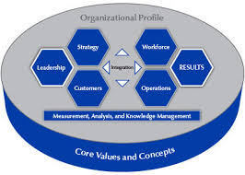
Baldrige Excellence Framework
The Baldrige Performance Excellence Program
National and state level programs in the US.
Framework used in more than 30 countries and basis for over 70 business, quality and excellence models.

Slide 36
History
US renewed interest in quality in 1980’s. TQM still prevalent.
TV broadcast, “If Japan Can... Why Can't We?” (June, 24th, 1980,
NBC). Introduces Deming’s methods and begins a Quality
Revolution.
Malcolm Baldrige National Quality Improvement Act of 1987,
signed into law on August 20, 1987.
Framework and scoring developed by
APQC and National Productivity
Advisory Committee.
Howard Malcom Baldrige Jr., was US Secretary of Commerce.

Slide 37
Award background and criteria
Award Categories: Manufacturing, Education, Health Care, Non Profit, Service
and Small Business (< 500).
3 Criteria versions: Business, Health Care and Education
National Award is Best of the Best competition.
State level programs are most often developmental based and have tiered
Awards (step programs).
Criteria
Organizational Profile: (snapshot of organization)
P1. Organizational Description
(Environment and Relationships)
P2. Organizational Situation
(Competitive Environment, Strategic Context and Performance Improvement System)

Slide 38
Process categories
Leadership
1.1. Senior Leadership
1.2. Governance and Societal Responsibilities
Strategy
2.1. Strategy Development
2.2. Strategy Implementation
3. Customer Focus
3.1. Voice of the Customer
3.2. Customer Engagement

Slide 39
Process categories
Measurement, Analysis and Improvement of Knowledge
Management
4.1. Measurement, Analysis and Improvement of Organizational
Performance
4.2. Information and Knowledge Management
5. Workforce Focus
5.1. Workforce Environment
5.2. Workforce Engagement
Operations Focus
6.1. Work Processes
6.2. Operational Effectiveness

Slide 40
Results category
7.1. Product and Process Results
7.2. Customer Results
7.3. Workforce Results
7.4. Leadership and Governance Results
7.5. Financial and Market Results

Slide 41
Process Category Criteria example
1.1 Senior Leadership: How do your senior leaders lead the organization? (70 pts.)
a. Vision and Values
(1) Setting Vision and Values: How do senior leaders set your organization’s vision and values? How do senior leaders deploy the vision and values through your leadership system, to the workforce, to key suppliers and partners, and to customers and other stakeholders, as appropriate? How do senior leaders’ personal actions reflect a commitment to those values?
(2) Promoting Legal and Ethical Behavior How do senior leaders’ actions demonstrate their commitment to legal and ethical behavior? How do senior leaders promote an organizational environment that requires it?
b. Communication
How do senior leaders communicate with and engage the entire workforce and key customers? How do they
•encourage frank, two-way communication, including use of social media, when appropriate;
•communicate key decisions and needs for organizational change; and
•take a direct role in motivating the workforce toward high performance and a customer and business focus, including by participating in reward and recognition programs?

Slide 42
Results Category Criteria example
7.1 Product and Process Results: What are your product performance
and process effectiveness results? (120 pts.)
a. Customer-Focused Product and Service Results
What are your results for your products and your customer service processes? What are your
current levels and trends in key measures or indicators of the performance of products and
services that are important to and directly serve your customers? How do these results
compare with the performance of your competitors and other organizations with similar
offerings? How do these results differ by product offerings, customer groups, and market
segments, as appropriate?
b. Work Process Effectiveness Results
Process Effectiveness and Efficiency: What are your process effectiveness and
efficiency results? What are your current levels and trends in key measures or indicators of the operational performance of your key work and support processes, including productivity, cycle time, and other appropriate measures of process effectiveness, efficiency, security and cybersecurity, and innovation? How do these results compare with the performance of your competitors and other organizations with similar processes? How do these results differ by…

Slide 43
Scoring Dimensions and Comment example
Process Evaluators: Approach, Deployment, Learning and Integration
Results Evaluators: Levels, Trends, Comparisons and Integration
Comment Examples:
1.1 Senior Leadership
Your score in this Criteria item for the Consensus Review is in the 50–65 percentage range.
STRENGTHS
a(1,3) Through (applicant’s) evolving Leadership System, the LT sets direction, deploys vision and values, and creates an environment to achieve the mission. The system includes steps to cascade SOs, develop QCPs linked to performance reviews and demonstration of values, integrate values into supplier and collaborator
business meetings, and use departmental Accountability Boards to help improve performance.
OPPORTUNITIES FOR IMPROVEMENT
a(1), b(1) Methods for the LT to communicate with key customer groups or the Advisory Board are not apparent. LT dialogue with key customers through social media or other communication methods may strengthen the core competency of relationships.

Slide 44
Results Category Comment example
7.1 Product and Process Results
Your score in this Criteria item for the Consensus Review is in the 70–85 percentage range.
STRENGTHS
a Several results demonstrate superior customer service, a strategic advantage. Applicant addresses increasing demands from consumers for better and more personalized customer service, as shown by improvements in Average Total Time per P2P Order, commensurate with an increase in customer engagement (Figure 7.1-9). Higher service levels are supported by a decrease in the abandoned call rate to about one-fourth of the best-practice rate and by Call Center phone and e-order uptime of 100%, the latter of which is best-in-class (Figure 7.1-12).
OPPORTUNITIES FOR IMPROVEMENT
b(1) Results are not reported for one of applicant’s core competencies, innovation. This may make it difficult for applicant to understand the success of its efforts to drive breakthrough improvements in operational performance.
a, b(1) None of the customer-focused product and service results presented include comparisons to applicant’s four key competitors, and some process effectiveness and efficiency results do not include comparative data. Given that the comparative best-in-class levels reflect only the 25th percentile, comparisons with competitors may help applicant understand its relative performance in meeting customer requirements and in becoming the #1 Internet-preferred active wear and shoe resource in the nation

Slide 45
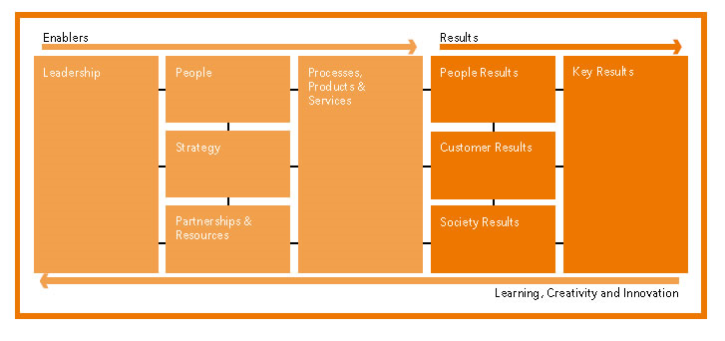
EFQM
European Foundation for Quality Management
Widely used in Europe and other countries.
Basis for other national and regional awards.
500+ member organizations in both private and public settings.

Slide 46
EFQM facts and figures
Objective: “To increase the competitiveness of European
organizations and support the sustainable development of the
European economies.”
Member based and non profit organization (1989).
European Quality Award started in 1992.
Used by over 30,000 Organizations in 25 years in Europe.
Public and Private sector applicants.
1. Large Private Sector (over 1000 employees)
2. Small / Medium Private Sector (less than 1000 employees)
3. Large Public Sector (over 1000 employees)
4. Small / Medium Public Sector (less than 1000 employees)

Slide 47
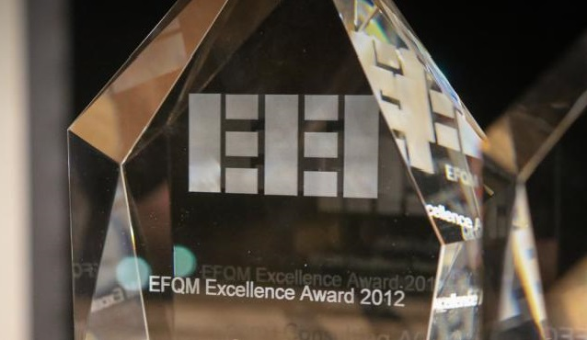
EFQM concepts and criteria
Excellence: “Excellence is about doing your best…”
8 Fundamental Concepts:
Adding Value for Customers, Creating a Sustainable Future, Developing
Organizational Capability, Harnessing Creativity and Innovation;
Leading with Vision, Inspiration and Integrity; Managing with Agility,
Succeeding through the Talent of People, Sustaining Outstanding Results
5 Enabler Criterion (Taking Action):
Leadership, People, Strategy; Partnerships and Resources and
Processes, Products and Services
4 Results Criterion (Impact):
Customer, People, Society and Business
All Supported by Learning, Creativity and Innovation

Slide 48
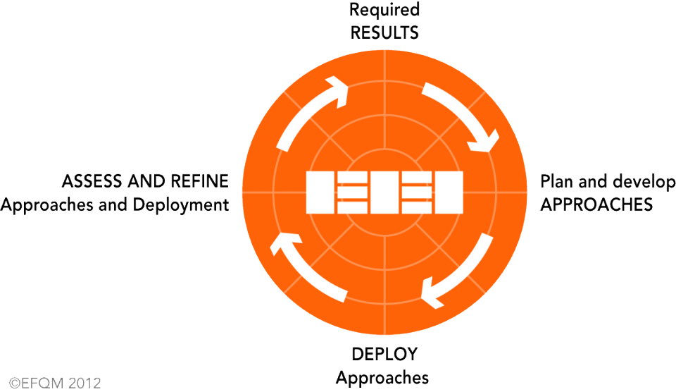
EFQM evaluation
Radar Logic-Results, Approaches, Deploy, Assess and Refine

Slide 49
EFQM Criteria and Feedback Example
8 Fundamental Concepts:
Adding Value for Customers, Creating a Sustainable Future, Developing
Organizational Capability, Harnessing Creativity and Innovation;
Leading with Vision, Inspiration and Integrity; Managing with Agility,
Succeeding through the Talent of People, Sustaining Outstanding Results
5 Enabler Criterion (Taking Action):
Leadership, People, Strategy; Partnerships and Resources and
Processes, Products and Services
4 Results Criterion (Impact):
Customer, People, Society and Business
All Supported by Learning, Creativity and Innovation

Slide 50
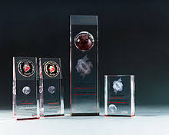
Shingo Prize for Operational Excellence™
Administrated by the John M. Huntsman School of Business at Utah State
University.
International Applicants (20 per year average).
Awards include: The Prize, Silver and Bronze Medallions, Research and
Publication Awards (new knowledge in lean and Op Ex-Books, Articles, Case
Studies, Applied publication/media).
Lean based model using tools and systems perspective.

Slide 51
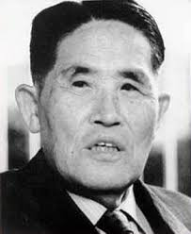
Shingo Prize History
Shigeo Shingo known for Toyota Production System and Single Minute Exchange of Dies.
Utah State University confers honorary doctorate on Shingo, 1988 and establishes North American Shingo Prizes for Excellence in Manufacturing.
“There are three constants in life…change, choice and principles.”
—Stephen R. Covey
“There are four Purposes of improvement: easier, better, faster and cheaper, These four goals appear in the order of priority.”
-Shigeo Shingo
“In the final analysis, national prosperity depends
on improved productivity and, conversely, it is
only on a foundation of increased productivity
that we can build a wealthy nation and happy citizens.”
— Shigeo Shingo

Slide 52
Goals and insights
Goals:
Journey of Discovering and Building Excellence
Use of structured approach
Integration (create or build systems)
Key Behavioral Indicators and Key Performance Indicators
Cultural Transformation
Three Insights of Enterprise Excellence
1. Ideal Results Require Ideal Behavior
2. Purpose and Systems Drive Behavior
3. Principles Inform Ideal Behavior

Slide 53
Shingo Model™: Guiding Principles, Systems, Tools, Results and Culture
Guiding Principles:
Cultural Enablers: Lead with Humility, Respect for Every
Individual
Continuous Improvement: Flow and Pull Value, Ensure
Quality at the Source, Focus on Processes, Embrace Scientific
Thinking, Seek Perfection
Enterprise Alignment: Create Constancy of Purpose. Think
Systematically
Results: Create Value for the Customer

Slide 54
Shingo Model™ Criteria Example
Guiding Principles:
Cultural Enablers: Lead with Humility, Respect for Every
Individual
Continuous Improvement: Flow and Pull Value, Ensure
Quality at the Source, Focus on Processes, Embrace Scientific
Thinking, Seek Perfection
Enterprise Alignment: Create Constancy of Purpose. Think
Systematically
Results: Create Value for the Customer

Slide 55
Shingo Model™ Feedback Example
Guiding Principles:
Cultural Enablers: Lead with Humility, Respect for Every
Individual
Continuous Improvement: Flow and Pull Value, Ensure
Quality at the Source, Focus on Processes, Embrace Scientific
Thinking, Seek Perfection
Enterprise Alignment: Create Constancy of Purpose. Think
Systematically
Results: Create Value for the Customer

Slide 56
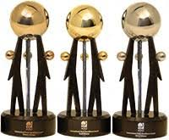
Unique models: ASQ’s International Team Excellence Award
ASQ’s Team Excellence (ITEA) is the world’s premier team recognition program for showcasing global team achievements in improving business performance.
Facts and History:
History since 1985.
Thousands of teams have applied.
Team projects from more than 30 countries and 20 industry classifications.
Framework and criteria for team based projects.
Program Process and Characteristics:
Preliminary and Finals rounds.
Well-trained Judges.
Finals round projects presented live at World Quality
and Improvement Conference.

Slide 57
ASQ’s International Team Excellence Award
Six criteria categories across project and team lifecycle.
Project Background and Purpose, Project Framework, Project Stakeholders and the Project Team, Project Overview, Project Walkthrough
and Project Presentation
Scoring and feedback includes presentation value and maturity considerations.
Maturity considerations account for criteria elements from missing or not addressed, to partially and fully addressed, addressed with additional support and organizational level approaches.
Themes within the Criteria include:
Stakeholders, Data, Team Skills and Preparation, Methods and Tools, Resistance and Risk, Goals, Measures and Benefits and Project Management

Slide 58
Unique models: Association for Manufacturing Excellence Award
AME Award for North American Manufacturing plants only.
Criteria is Lean based and uses the Lean Sensei tool.
Lean Sensei highlights:
60 Items across the Criteria areas.
Maturity Rankings: Excellent, On the Journey or Needs Improvement
Self Assessment Grading: A+, A, B, C, D, F
Evidence presented including proofs and gaps.
Report Card Scoring, Comparison Analysis with feedback.
Short sites visits for evaluation.
Achievement Report with key Strengths and Opportunities.

Slide 59
AME Criteria
Policy (Key) Deployment Processes:
Management System, Human and Organizational Development
2. Safety and Environment
3. Manufacturing and Business Operations:
(Waste (muda); Unevenness, Fluctuation and Variation (mura); Overburdening
People or Machines (muri))
4. Extended Value Stream Management:
Product Development and Supplier Development and Procurement
5. Plant Results: Quality, Cost, Delivery and Profitability

Slide 60
AME Criteria
Policy (Key) Deployment Processes: Management System
A policy deployment process details the management system strategy and human and
organizational development system of a plant or organization as a means to achieve
desired business results in terms of safety, morale, quality, cost and delivery.
Issues to be addressed include (but are not limited to) the following:
• Describe your plant’s policy deployment process, such as Hoshin Kanri planning,
strategic planning, etc.
• Explain the key methods the company uses to clarify goals, define strategies, identify
problems and develop countermeasures.
• What is the scope and level of the plant’s cascading of policy, goals, strategies and
action plans for both the shop floor and the front office?
• Describe your plant’s continuous improvement program to achieve the policy deployment
plan.
• Outline the role and relationship of leadership and all associates in achieving company
goals and objectives.
• Explain how you utilize standard work in your management approach, including
going to the gemba (where the work is done) to learn what is really happening.

Slide 61
AME Criteria: Lean Sensei question descriptors example
1. Policy Deployment:
Excellent: Formal and effective program from the top for vision and strategy and objective creation with a robust level of catch ball horizontally and vertically for alignment. Clear focus on the "critical few" breakthrough strategic initiatives which are cascaded from the top all the way down and across the organization. Employees understand how their work relates to company objectives/strategies.
On the Journey: Policy deployment is in place from top for vision, strategy and objective creation. But linkages down through the organization are missing. Breakthrough objectives may exist, but focus is not crisp. Some methodologies are in place for global deployment. A catch ball process is evolving.
Needs Improvement: Vision, strategy and objectives exist but accountabilities and alignment are weak. Objectives handed down from higher levels, no real catch-ball type process exist. Departments focus on their priorities; activities are often not in alignment across the organization. (F) No strategy or deployment of strategy exists.

Slide 62
AME Feedback example: strengths
We saw a true commitment globally by XXX to Lean, continuous improvement and to learn. Not only
did we have the entire support of all management and team members during our site visit, who did a
great job proudly presenting their areas, but the company invited members of their other locations in
South American and the Europe to observe and learn.
People are passionate about improvement and there is a good understanding of lean throughout the
professional workforce.
Coaching and mentoring program has been improving since introduction in 2015. Good use of
participant feedback to drive improvements.
It was impressive to have ‘exceptional’ employees at the assessment kick-off dinner.
X Matrix is cascaded down to the shop floor manager level and there are good linkages to
improvement projects, which are prioritized at the Top of the “X” Matrix.
There is an excellent integrated system to track the progress of employee training and skill
development. The lean training is mandatory for all employees with both class room and
actual projects or improvement activities. The progress is tracked with a 12-month rolling
base. The annual skill and human capacity assessment was used to develop the overall
people development training plan.

Slide 63
AME Feedback example: opportunities
Leader standard work is not understood overall as a tool to bring the leader in contact with the people
and processes they are responsible to develop and improve. This tool should guide you to monitor
your people and processes so problems can be detected early and actions taken to improve them. It
should not just be a list of meetings but rather those things which are important but not urgent. When
addressed these actions prevent future emergencies. LSW should include time to ‘Go See’ what is
happening in the leader’s area of responsibility, taking time to coach people on Continuous
improvement activities. Identify a clear ‘purpose’ for doing LSW. It should focus on developing
people, improving process performance and improving business performance. If your LSW activities
do not touch on those 3Ps, it.
Very little focus on Process Management vs. individual problem resolution is present in either
manufacturing or the office. Team members need to understand what is supposed to be happening
and whether it is in fact happening now. With that knowledge data-based decisions can be made to
adjust behaviors and implement consequences in time to change the results.
The visual boards appear to be relatively new. It would be helpful to think about what the boards
should reveal. What do you need to know to manage the process and to drive process
improvements? It is common in manufacturing to create boards that reveal whether you are ahead
or behind vs. deliverables for a given period of time. Visual boards should alert you to problems early
enough in the process that you can take a countermeasure to protect your customer
(internal or external). As you work with your boards keep revising them until they are
improving your ability to know what is going on in your process and what you should do about it.

Slide 64
The future of excellence
Trends:
Benchmarking
Move toward best practices study, analysis, and sharing across current social trends and impacts.
Company, sector and environment.
Internal and external: specific and market.
Move toward innovation (design thinking and human centered design)
Globalization:
Themes: Collaborative efforts and breakdown differences in social-cultural approaches, norms and perceptions across oceans and continents.
Examples:
Benchmarking: congresses, indexes, networking and summits

Slide 65
Globalization:
Organizational Excellence:
First Assessment on Current State of Organizational Excellence. (OE Specialists, ASQ QMD-OETC, GBN)
Universality: Merging of industry standards and excellence criteria.
Example: Closer alignment of Baldrige and ISO criteria.
Social criteria and consciousness (mega trends):
Nation Building:
Sustainable Development Goals (SDGs)
Environmental, social and (corporate) governance (ESG)
Including political and technology changes
Research:
Technical and professional bodies, universities

Slide 66
Acknowledgements
Geetha Balagopal, ASQ, Raleigh, North Carolina, USA
Michael Bremer, Cumberland Group, Chicago, Illinois, USA
Rick Edgeman, Ph.D., Shingo Institute, Logan, Utah, USA
Ben Krupowicz, ILPEx, Peoria, Illinois, USA
Tim Piotrowski, Jodi Talley and Taylor Scheibe, AME, Rolling
Meadows, Illinois, USA
Dawn Ringrose, Organizational Excellence Specialists, British
Columbia, Canada

Slide 67
Summary: In this webcast you learned about
Framework Impacts
Model Usage
Detailed Examples:
Deming
Baldrige
EFQM
Shingo
Unique Models
and the Future of Excellence

Slide 68
To Learn More…
About Shawn W. Flynn
Contact @
Phone: 815-497-2132
E-mail: flynnsw@aol.com
Website: www.bkm.cc
About this topic:
Go to ASQ’s …….
ASQ Organizational Excellence Technical Committee
Search ASQ’s Knowledge Center……..
Contact Pablo Baez at PBaez@asq.org

